Slide 1
Python Workshop
Welcome to Python Workshop
- By Mahesh Sethi

Slide 2

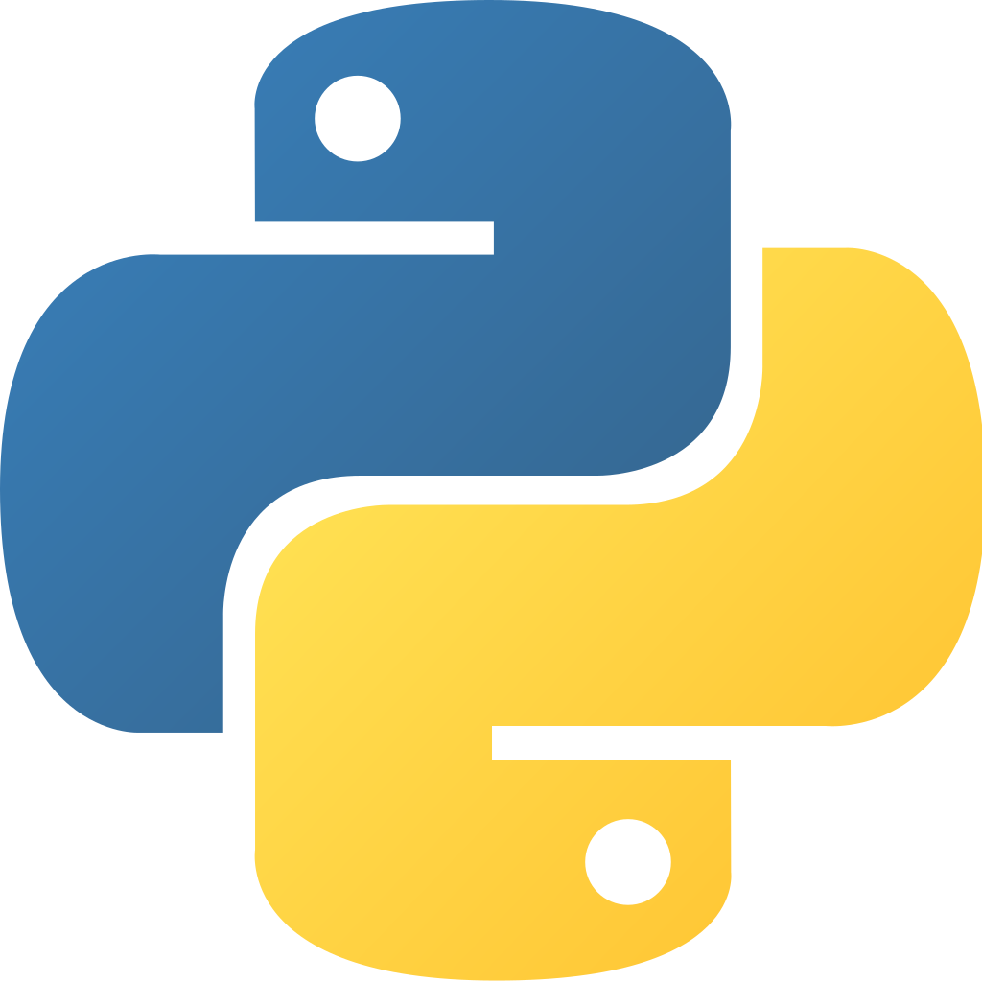
Guido van rossum
Python is a widely used general-purpose, high level programming language. It was created by Guido van Rossum in 1991 and further developed by the Python Software Foundation. It was designed with an emphasis on code readability, and its syntax allows programmers to express their concepts in fewer lines of code.
Python is a programming language that lets you work quickly and integrate systems more efficiently.
It is used for:
web development (server-side),
software development,
mathematics,
system scripting.
And many more...

Slide 3
What python can do ?
Python can be used on a server to create web applications.
Python can be used alongside software to create workflows.
Python can connect to database systems. It can also read and modify files.
Python can be used to handle big data and perform complex mathematics.
Python can be used for rapid prototyping, or for production-ready software development.

Slide 4
Why Python ?
Python works on different platforms (Windows, Mac, Linux, Raspberry Pi, etc).
Python has a simple syntax similar to the English language.
Python has syntax that allows developers to write programs with fewer lines than some other programming languages.
Python runs on an interpreter system, meaning that code can be executed as soon as it is written. This means that prototyping can be very quick.
Python can be treated in a procedural way, an object-orientated way or a functional way.

Slide 5
Python Syntax compared to other programming languages
Python was designed for readability, and has some similarities to the English language with influence from mathematics.
Python uses new lines to complete a command, as opposed to other programming languages which often use semicolons or parentheses.
Python relies on indentation, using whitespace, to define scope; such as the scope of loops, functions and classes. Other programming languages often use curly-brackets for this purpose.
Notes:
https://www.tutorialspoint.com/What-are-character-classes-or-character-sets-used-in-Python-regular-expression
https://onlineitguru.com/tutorial/python-tokens
https://www.digitalvidya.com/blog/python-data-types/
https://www.iteanz.com/tutorials/python/multiple-assignment/
https://www.w3schools.com/python/python_ref_functions.asp
https://realpython.com/python-operators-expressions/#operator-precedence
https://www.programiz.com/python-programming/precedence-associativity
https://www.geeksforgeeks.org/decision-making-python-else-nested-elif/
https://problemsolvingwithpython.com/04-Data-Types-and-Variables/04.02-Boolean-Data-Type/
https://www.digitalocean.com/community/tutorials/understanding-boolean-logic-in-python-3
https://www.w3adda.com/python-tutorial/python-loop-control-statementshttps://www.w3schools.com/python/python_while_loops.asp
https://www.w3schools.com/python/python_while_loops.asp
https://data-flair.training/blogs/python-loop/
https://www.w3schools.com/python/python_strings.asp

